Slide 1
Using GitHub for Papyrus Models Jessie Jewitt – OAM Technology Consulting/ ARM Inc.
January 29th, 2018

Slide 2
The Benefits of Using GitHub
The model is stored in a remote repository (GitHub) rather than on a single modeler’s workstation, and thus is accessible by all people needing to view or update the model.
GitHub manages the changes to the model, and will indicate there are “conflicts” if multiple people are attempting to update the same model fragment in error (and thus will not allow the update until conflicts are resolved).
GitHub keeps track of the various versions of the model that are “merged” into the remote repository, thus providing a means to restore previous versions when required.
GitHub tracks who has made changes, and which model files were changed.
GitHub is used by multiple SDO’s for model versioning, allowing for easier access and exchange of models between the organizations.

Slide 3
Work Flow - Overview
Overview of the procedural steps, or “work flow” in the use of GitHub for model versioning:
Forking the Model
Cloning the Model
Opening the Model in Papyrus
Updating the Model and Staging the Files
Committing the Changes and Uploading to the Remote Repository
Pull Requests

Slide 4
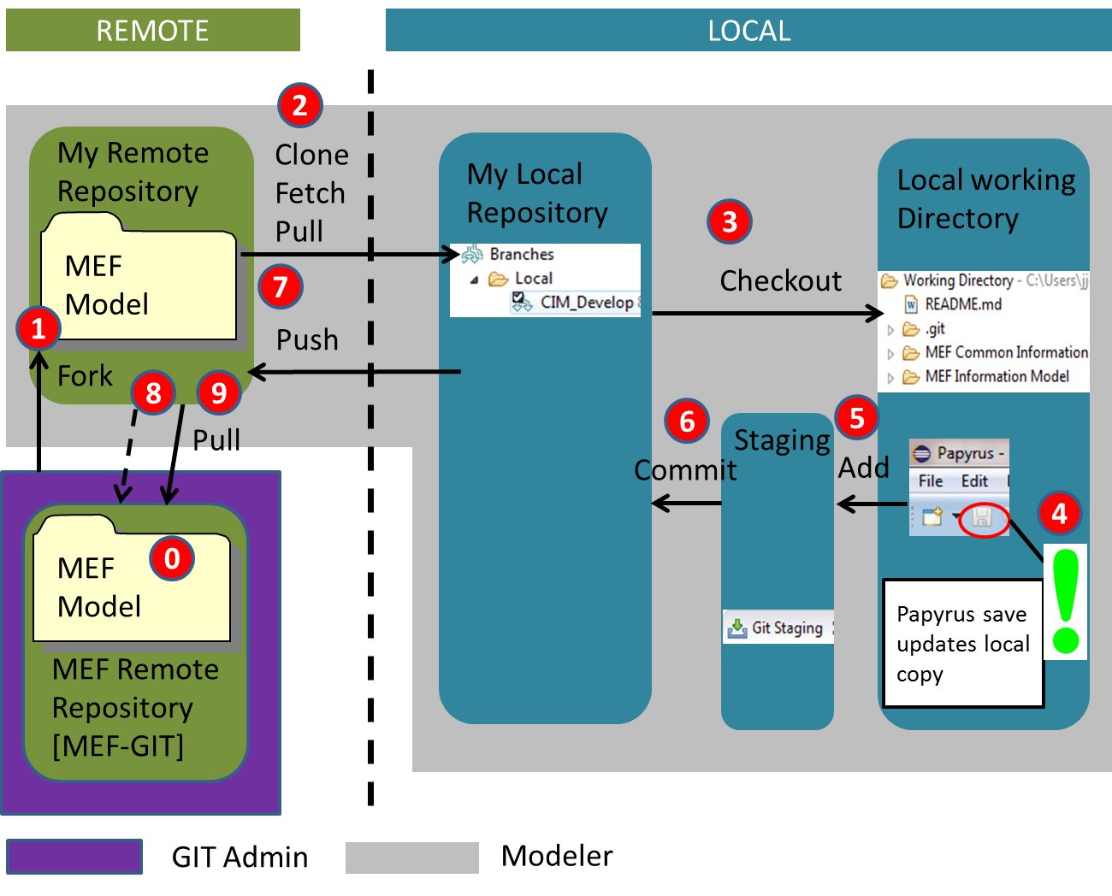
Overview of the GitHub Workflow
The following diagram is extracted from the MEF process, which is identical to the ONF process and all other SDO’s implementing a “common” approach to modeling

Slide 5
Step #1: Forking the Model
This step assumes that an ONAP model has been created in GitHub that will serve as the “master” model to which all proposed changes are merged and versioned.
The goal is to create a “user’s” specific copy of the model in his own GitHub space.
This is accomplished by going to the GitHub link of the “master” model and selecting on that page the option “fork”.
During this process you will be asked where you want the forked copy to reside. You would supply the name of your user-id in GitHub, which might be something like: “JJEWITT58”.
After the fork process, a copy of the model now resides in your user workspace. This is your “Remote Repository”. You should be able to browse it and see that it is an exact replica of the “master” model.

Slide 6
Step #2: Cloning the Remote Repository
There may be different branches in the “master” repository, and the goal in this phase is to “clone”, or “copy”, a specific branch into the modeler’s local PC in a local repository.
This is done using the git client that is contained in the Eclipse/Papyrus tool of the local PC. Start by opening the “Git” perspective in your tool.
In the Git perspective, one would choose the option “Clone a Git Repository”.
You then copy the address that is provided on the web page of the user’s Remote Repository into the URI field and enter your GitHub username and password. You are prompted to select the branch of the model you wish to clone.
You then select the destination in your local PC where you wish the model to be stored, and check the option: “import all existing projects”, which results in Papyrus projects being created in your tool.
You can now see the model in your Git Repository tool.

Slide 7
Step #3: Opening the Model in Papyrus
Since you selected the option to create Papyrus projects in the previous step, the goal of this step is to visualize your model in Papyrus.
You begin this step by opening up your “Papyrus Perspective” as an option in “Open Perspective”.
In the Project Explorer, select the model you wish to visualize.
Note, there may be a number of “sub-models” that have been created in a single model. You can either view the entire “model”, or view a specific sub-model by selecting that model in the overall model.
You will then see the model you selected in the “Model Explorer”, and begin to display the various diagrams and artifacts associated with the model.

Slide 8
Step #4: Updating the Model and Staging the Files
When you begin to make changes to the model, and select the “save” option in Papyrus, all your changes are saved to your local working directory on your PC.
You can see where this “working directory” resides by selecting your cloned repository in the “Git Perspective”, and selecting the folder “Working Directory”.
Once again in your “Git Perspective”, and having selected your local repository, you will see the files that you have changed in the “un-staged” files window on the bottom right of the page.
You then select the files you want to stage by right-clicking on them and then selecting the option “Add to Git index”.
Note, if you have made errors in the files you saved, instead of selecting the “Add” option, you can select “Replace with Head Revision”, and Git will go to your remote repository and download associated “un-changed” version of the file you selected.

Slide 9
Step #5: Committing the Changes and Uploading to Remote Repository
In this step you will “commit” your changes in your local repository and “push” them to your remote repository.
This can be done in one-step or two-step process. For the one-step process you select “Commit and Push” in the bottom right-hand corner. For the two-step process, first select “Commit”. In both cases, you must enter a “Commit” message indicating the changes you have made.
If you chose the two-step process, you must now select your local repository that contains the changes, and right-click, selecting “Push Branch”.
In both cases, your local repository is now “pushed”, or “copied” to your remote repository.

Slide 10
Step #6: Pull Requests
Once you have done the “commit” and “push” to your remote repository, you go to your repository in GitHub.
You are now ready to do a “Pull Request”. This is the process whereby the model administrator will “pull” your changes from your remote repository into the “master” version (or more specifically your development branch).
This is accomplished by selecting the “Compare and Pull Request” in the remote repository. The modeler now sees a detailed comparison of the files that have changed, and may choose to add a comment.
You then select the option “Create Pull Request”. The administrator of the ONAP repository receives the pull request and can merge the updates into its repository.

